Slide 1
Last year review
5° basico

Slide 2
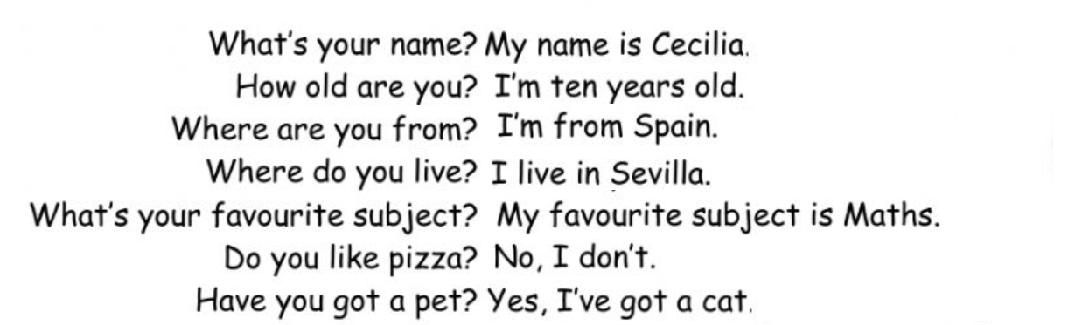
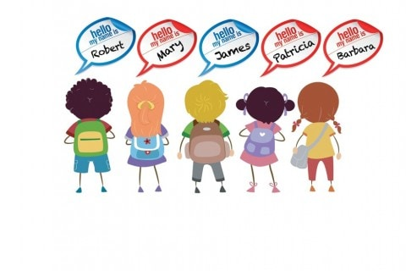





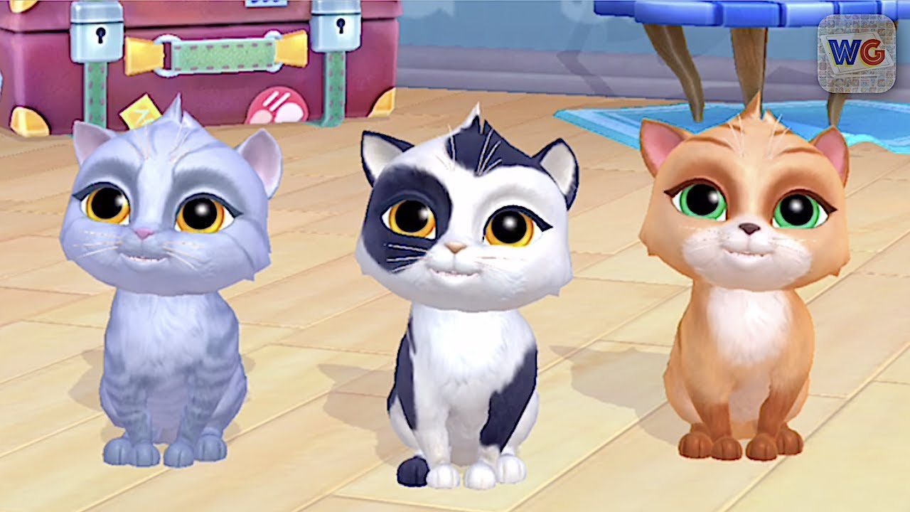
Personal information
Language / maths / English/ P. E. /
Music / Arts / History / Science

Slide 3
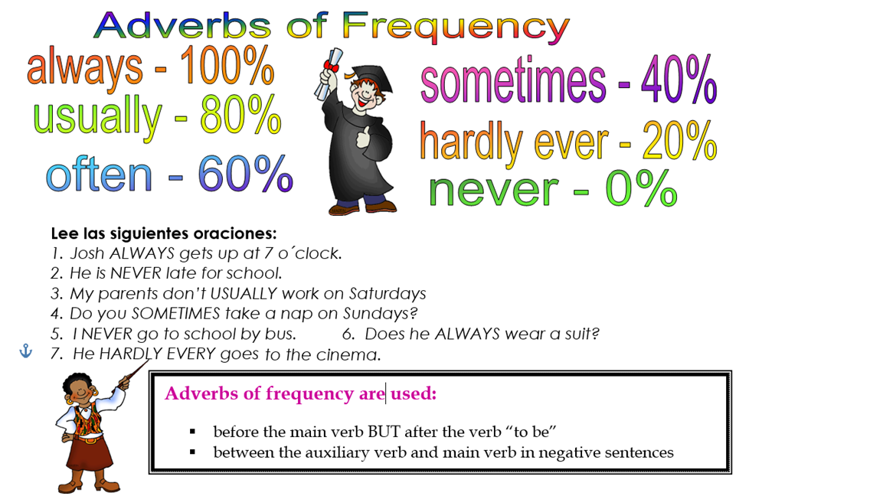

Slide 4
https://es.liveworksheets.com/worksheets/en/English_as_a_Second_Language_(ESL)/Adverbs_of_frequency/Adverbs_of_Frequency_%E2%80%98%C2%B7_Technology_nb1223652tk

