Slide 1
Last year review 3
4° básico

Slide 2
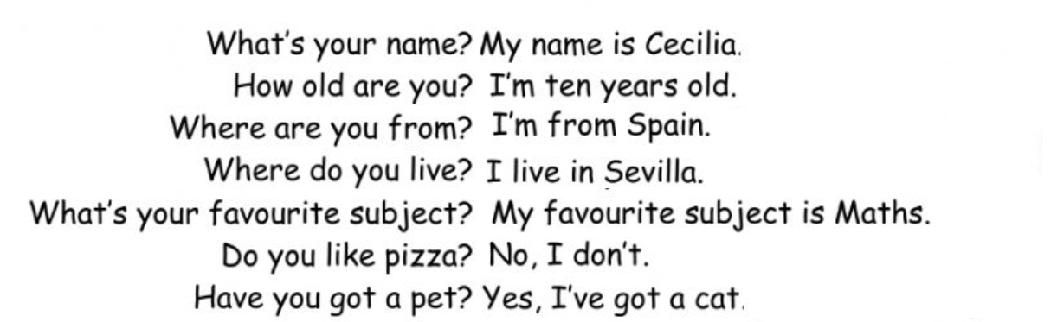






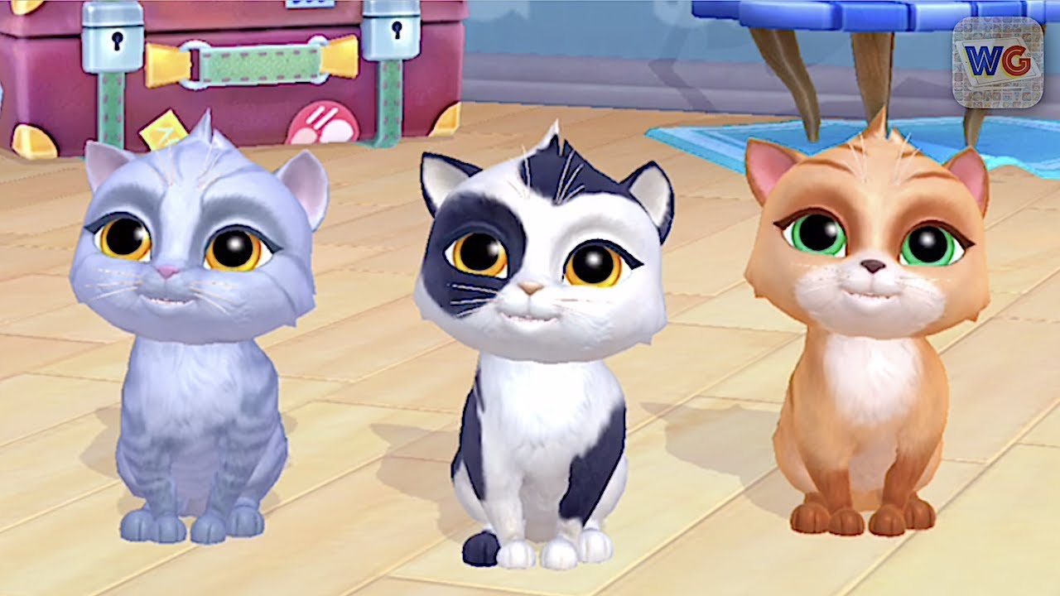
Personal information
yes, I do
No, I haven’t
Language / maths / English/ P. E. /
Music / Arts / History / Science

Slide 3
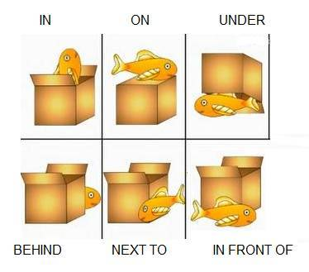
Let’s watch videos
https://www.youtube.com/watch?v=ibTiIaI6KsE
https://www.youtube.com/watch?v=fm9-4zCiQng

Slide 4
activity
https://es.liveworksheets.com/worksheets/en/English_as_a_Second_Language_(ESL)/Prepositions_of_place/Prepositions_of_place_if143587tv

Slide 5
Days of the week
Monday
Tuesday
Wednesday
Thursday
Friday
Saturday
Sunday

Slide 6
activity
https://es.liveworksheets.com/worksheets/en/English_as_a_Second_Language_(ESL)/Days_of_the_week/Learn_with_us_2_revision_2_pt316546sb

Slide 7
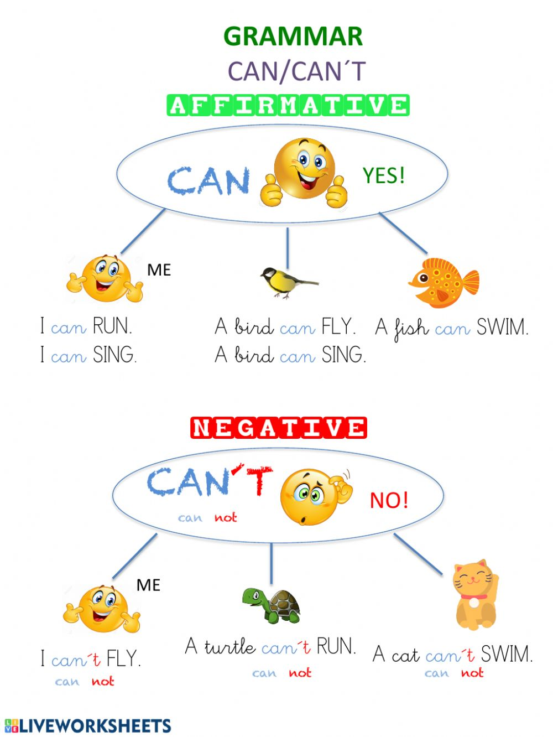
OBJECTIVE: TALKING ABOUT ABILITIES.

Slide 8
homework
https://es.liveworksheets.com/worksheets/en/English_as_a_Second_Language_(ESL)/Can_or_can't/Can_animals_do_this_(Can_or_can't)_ly2151ko

